Slide 1
Eurographics 2020 - Educational Papers
Nick Vitsas
Anastasios Gkaravelis Andreas-Alexandros Vasilakis
Konstantinos Vardis
Georgios Papaioannou
Department of Informatics
Athens University of Economics and Business
Greece
Rayground: An Online Educational Tool for Ray Tracing
Notes:
My name is Nick Vitsas. I’ m a PhD Student from the computer graphics group of Athens University of Economics and Business. This is a presentation of our work on Rayground: An Online Educational Tool for Ray Tracing.

Slide 2
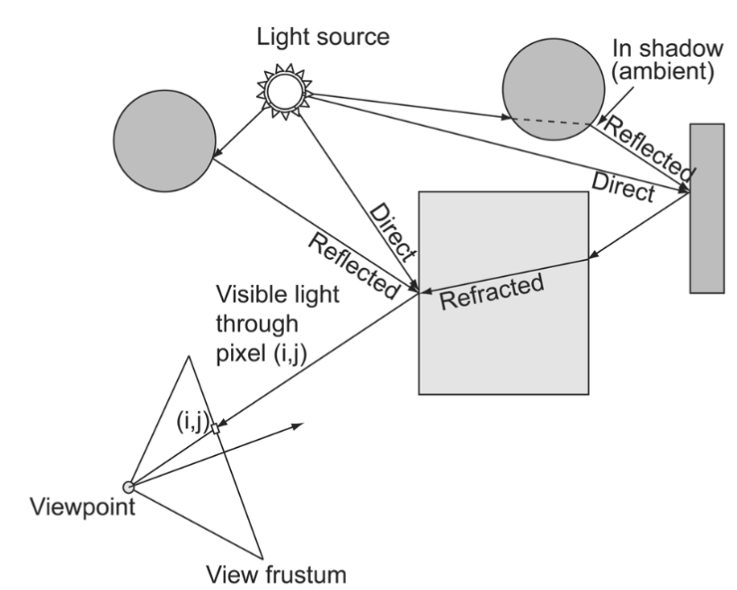
Ray Tracing in Education
Experiments
Ray Tracing (RT) is a core teaching subject in Computer Graphics courses
Undergraduate courses are mostly built around the rasterization pipeline
Graduate syllabi need to cover a wider range of advanced topics
Transition from Rasterization to RT is often hard
Hardware-accelerated RT is here
Educational tools to improve the learning curve of RT are still missing!
Notes:
Ray tracing is one of the most common teaching subjects in computer graphics courses, presented as an elegant and robust algorithm for image synthesis.
Undergraduate graphics syllabi are built around the rasterization pipeline and devote a limited number of lectures to explain the basic concepts of ray tracing. Inevitably, this paradigm shift requires a lot of rewring.
Graduate syllabi need to cover a wide range of advanced and diverse topics and don’t have much time to introduce the basics.
Both students and instructors struggle to make the quick transition from rasterization to ray tracing. After all, rasterization and ray tracing are very different in terms of mechanics but at a high level, share a large portion of computer graphics theory.
Recent advances indicate that ray tracing based methods can be further adopted and integrated into computer graphics courses at all levels.
Unfortunately, this trend is not backed by widely available educationals tools that improve the learning curve and support the newfound popularity of ray tracing.

Slide 3
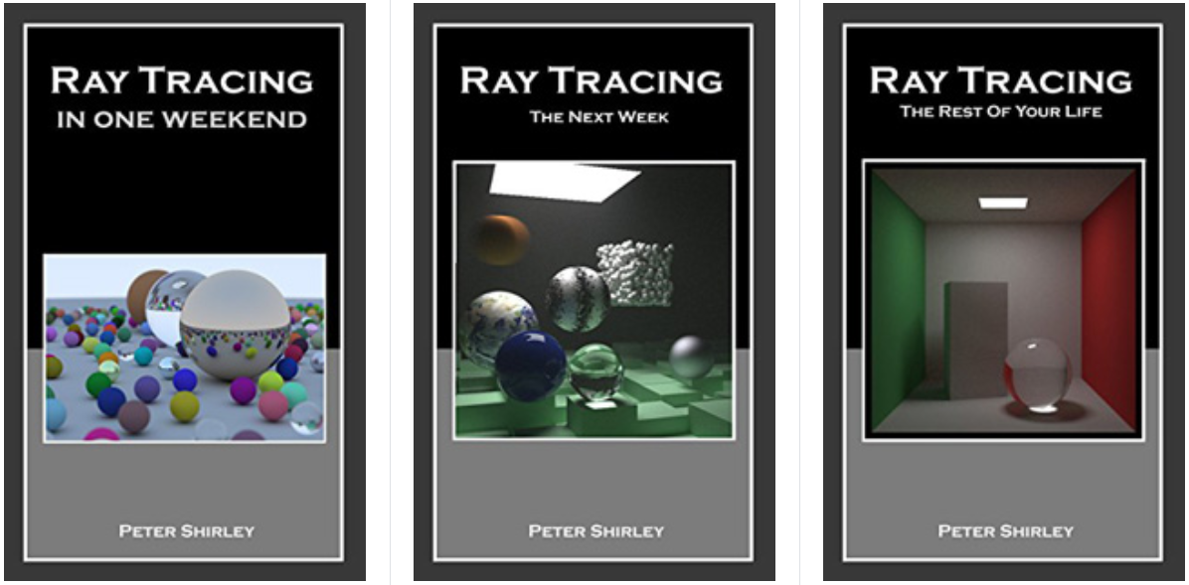
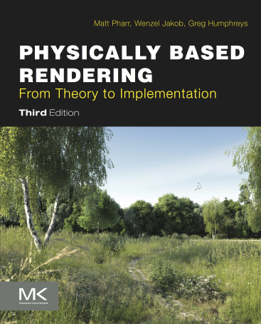
Ray Tracing Books
Experiments
github.com/RayTracing/raytracing.github.io
pbr-book.org
Notes:
Recently there has been a rise in learning material related to ray tracing. Two successful examples are Peter Shirley’s Ray Tracing In One Weekend series which introduces the basics with a mentality of “getting you to a cool program as quickly as possible”. Then, for a full journey “from theory to implementation” Physically Based Rendering the Book, has been a staple in recent years and has recently been made available online. However, such solutions lack interactivity and do not provide easy prototyping capabilities.

Slide 4
Ray Tracing APIs
Experiments
Ray tracing is rapidly being introduced in modern graphics APIs
Notes:
The improvements in hardware are also backed by software solutions with ray tracing rapidly being introduced in modern graphics APIs. The question is whether these APIs are ready to support computer graphics courses.

Slide 5
Ray Tracing APIs
Experiments
Ray tracing is rapidly being introduced in modern graphics APIs
D3D12, Vulkan and OptiX offer great facilities for high performance ray tracing but:
They are low-level APIs, not suitable for introductory courses
Implementation maturity varies across devices
Heavily dependent on software and hardware capabilities
Notes:
They are very low-level and complex APIs. This is understandable as they have to squeeze every last bit of performance out of the hardware while remaining flexible and configurable. They are therefore, not suitable for introductory courses. Also, implementation maturity varies across devices and especially state of the art ray tracing features are not widely supported. More often than not, these APIs and frameworks are heavily dependent on very specific software and hardware.

Slide 6
Ray Tracing APIs
Experiments
Ray tracing is rapidly being introduced in modern graphics APIs
D3D12, Vulkan and OptiX offer great facilities for high performance ray tracing but:
They are low-level APIs, not suitable for introductory courses
Implementation maturity varies across devices
Heavily dependent on software and hardware capabilities
Complex Installation instructions
Frequently updated API (deprecated lab exercises)
Dependencies
Notes:
Not to mention that all this flexibility and performance comes at the cost of long and complex installation instructions where you need to potentially support multiple API versions and maintain a large dependency tree.

Slide 7
Ray Tracing APIs
Experiments
Ray tracing is rapidly being introduced in modern graphics APIs
D3D12, Vulkan and OptiX offer great facilities for high performance ray tracing but:
They are low-level APIs, not suitable for introductory courses
Implementation maturity varies across devices
Heavily dependent on software and hardware capabilities
Complex Installation instructions
Frequently updated API (deprecated lab exercises)
Dependencies
A CPU framework could be developed but,
Very slow…
Notes:
A CPU framework could be developed but, it would be very slow on commodity hardware and would require significant effort to remain cross-platform.
And just as we thought that we were running out of options…..

Slide 8
World Wide Web
Experiments
PROS
By far the platform with the biggest outreach
Great choice for the deployment of educational tools
Sandboxed environment
International open standards
WebGL standard
Notes:
We considered the World Wide Web. It is by far the platform with the biggest outreach, so it is a great choice for the deployment of educational tools. The sandboxed environment in modern browsers is perfect for a consistent and secure platform that automatically gets updated. It is grounded on a series of international open standards with wide adoption and has had access to GPU computations through the WebGL1 and WebGL2 standard.
Of course, not everything is perfect.

Slide 9
World Wide Web
Experiments
PROS
By far the platform with the biggest outreach
Great choice for the deployment of educational tools
Sandboxed environment
International open standards
WebGL standard
CONS
No support for ray tracing acceleration
WebGL is very limited in terms of GPGPU computing
Sandboxed environment
Notes:
Ray tracing is a computationally demanding task. There is no functionality exposed in any modern Web Standard that can accommodate ray tracing acceleration. Even the WebGL spec is very limited in terms of general purpose GPU computing. Also, having a sandboxed environment that puts security, stability and cross-device support first means that you have to make sacrifices both in terms of flexibility and performance.

Slide 10
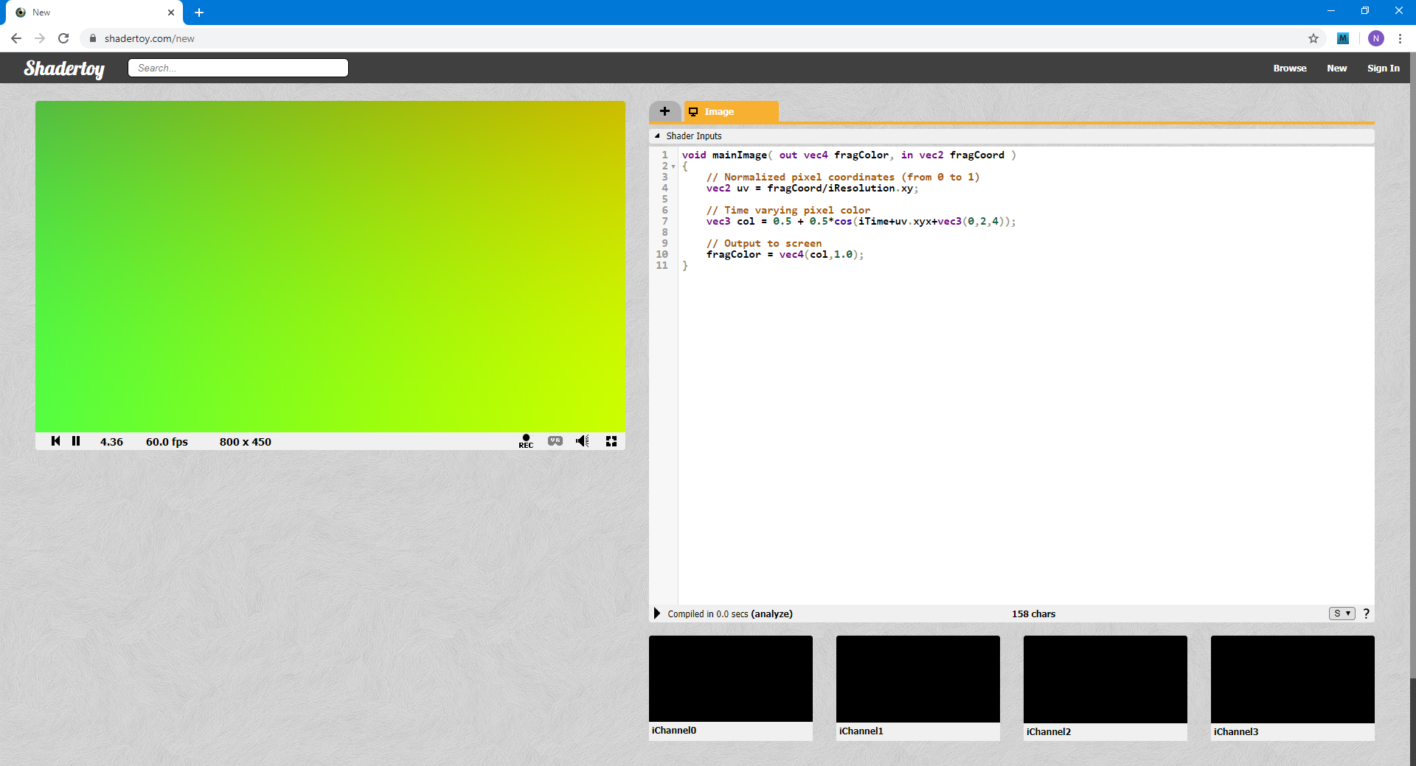
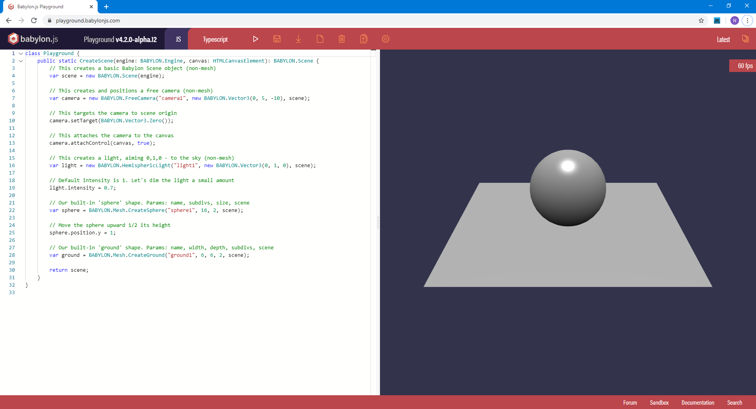
Web-based Graphics Prototyping
Experiments
shadertoy.com
playground.babylonjs.com
Notes:
We are definitely not the first to see this opportunity. There have been many successful examples of online interactive tools for computer graphics.
ShaderToy is a widely popular platform for experimenting with fragment shaders and screen space effects that has also been used for ray tracing, albeit with procedural geometry and within a fragment shader.
Babylon.js, a popular Javascript graphics library has a playground for rapid experimentation with graphics in an online IDE fashion.
Examples like these motivated us to pursue a similar online tool specifically targeted to ray tracing.
We set a series of goals and non-goals.

Slide 11
Rayground
Experiments
GOALS
Highly accessible platform / cross-device support
Interactive education tool with emphasis on rapid prototyping
Enrich both class and lab courses / remote teaching
Smooth transition from rasterization to ray tracing
Demystify ray tracing fundamentals
Modern API design
Notes:
We wanted a highly accessible platform that could run on a wide range of devices.
We emphasised on the concept of rapid prototyping. Quick to setup, easy to experiment.
Use the tool to improve both lectures and lab courses. Encourage gradual self-study. Ease of remote teaching was also a major concern.
Ensure as smooth a transition as possible from rasterization to ray tracing.
Demystify ray tracing fundamentals through a programmable graphics pipeline of distinct configurable ray tracing stages.
We wanted a modern API that would be familiar to experienced users and easy to pick up for newcomers.

Slide 12
Rayground
Experiments
GOALS
Highly accessible platform / cross-device support
Interactive education tool with emphasis on rapid prototyping
Enrich both class and lab courses / remote teaching
Smooth transition from rasterization to ray tracing
Demystify ray tracing fundamentals
Modern API design
NON-GOALS
A complete replacement for modern shader-based learning with OpenGL
Yet another fully-featured API for programming ray tracing algorithms
Notes:
Our non-goals were much simpler.
We understood that we could not develop a tool that could completely replace modern rasterization-based APIs.
We did not have the intention of offering a fully-featured API for programming ray tracing algorithms. This would have definitely gotten in the way of simplicity and smooth transition.

Slide 13
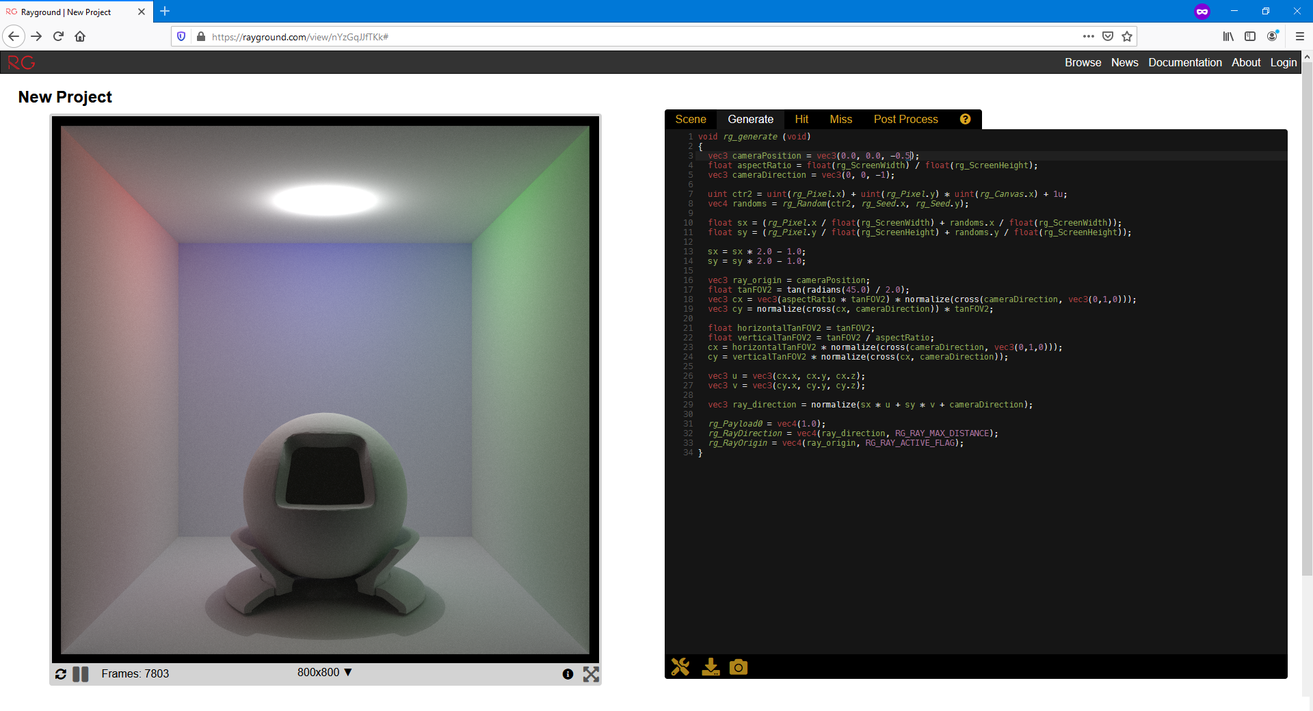
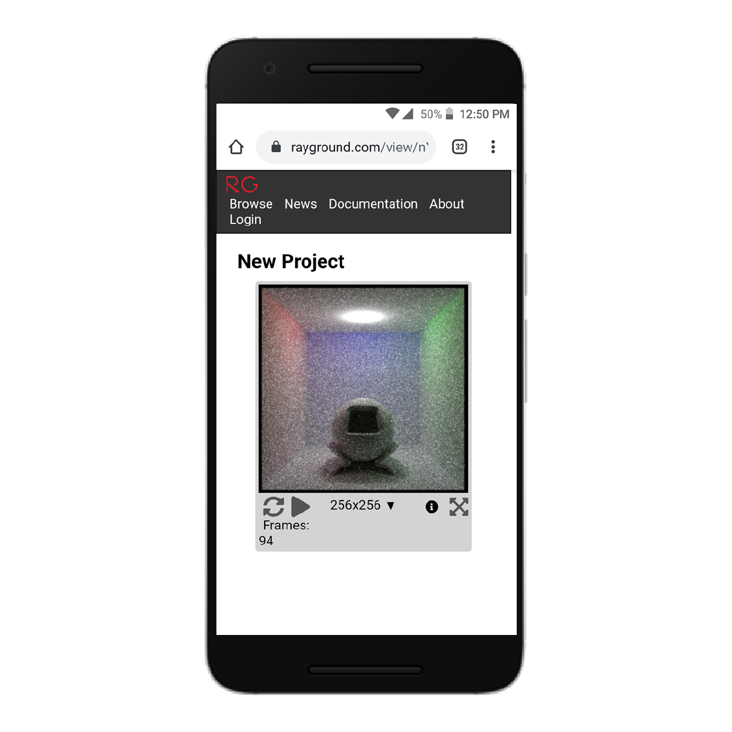
Rayground.com
Experiments
works on any platform that has a WebGL2-compliant browser (no plugins required)
Notes:
To a large extent, we achieved our goals and Rayground is a ray tracing prototyping tool on the web that is open, cross-platform, and available to everyone. The platform is hosted on rayground.com and works on any platform that has a WebGL2-compliant browser.

Slide 14
Ray Tracing Pipeline
Experiments
Notes:
Let’s discuss the ray tracing pipeline that Rayground exposes. As mentioned before, we wanted our API to closely match the design of other modern ray tracing pipelines.

Slide 15
Ray Tracing Pipeline
Experiments
Scene
Notes:
Everything in computer graphics, begins with the definition a scene.

Slide 16
Ray Tracing Pipeline
Experiments
Scene
Generate
Ray
Intersection
Notes:
Next is the phase of generating primary rays and submitting them for intersection with the scene.

Slide 17
Ray Tracing Pipeline
Experiments
Scene
Hit
Generate
Ray
Intersection
Hit?
Miss
Notes:
The next step depends on the result of the intersections. Rays that do not intersect the scene trigger a miss event and rays that hit part of the scene’s geometry generate a hit event.

Slide 18
Ray Tracing Pipeline
Experiments
Scene
Hit
Generate
Ray
Intersection
Hit?
End?
Miss
No
Ray
Notes:
Whether the ray triggers a miss or a hit event, a recursive step begins where new rays can be submitted for intersection. Commonly, this recursion breaks after a predetermined amount of steps called the recursion depth.

Slide 19
Ray Tracing Pipeline
Experiments
Scene
Hit
Generate
Ray
Intersection
Yes
Accumulation Buffer
Hit?
End?
Miss
No
Ray
Notes:
After the recursion depth is reached or no rays are submitted, the pipeline switches to the accumulation stage. Here the calculated results of the current pipeline execution, which most times is simply the pixel’s color, are blended with the results of previous pipeline executions.

Slide 20
Ray Tracing Pipeline
Experiments
Scene
Hit
Generate
Ray
Intersection
Yes
Accumulation Buffer
Color
Post Process
Hit?
End?
Miss
No
Ray
Notes:
The accumulated values are submitted to a post processing stage where final filtering is applied to the accumulation buffer and lastly,

Slide 21
Ray Tracing Pipeline
Experiments
Scene
Hit
Generate
Ray
Intersection
Yes
Accumulation Buffer
Color
Post Process
Color
Canvas
Hit?
End?
Miss
No
Ray
Notes:
post processed values are submitted as RGB color values to the frame buffer.

Slide 22
Ray Tracing Pipeline
Experiments
Scene
Hit
Generate
Ray
Intersection
Yes
Accumulation Buffer
Color
Post Process
Color
Canvas
Hit?
End?
Miss
No
Ray
Notes:
The question that is raised naturally is which of these steps should be programmable.
To maintain simplicity and in accordance with modern graphics APIs we came up with the following programmable pipeline.

Slide 23
Programmable Ray Tracing Pipeline
Experiments
Fixed Stage
Programmable Stage
Declarative Stage
Scene
Hit
Generate
Ray
Intersection
Yes
Accumulation Buffer
Color
Post Process
Color
Canvas
Hit?
End?
Miss
No
Ray
Notes:
1 declarative stage for scene specification and 4 programmable stages for supporting a wide range of ray tracing based algorithms.

Slide 24
Programmable Ray Tracing Pipeline
Experiments
Fixed Stage
Programmable Stage
Declarative Stage
Scene
Hit
Generate
Ray
Intersection
Yes
Accumulation Buffer
Color
Post Process
Color
Canvas
Hit?
End?
Miss
No
Ray
User code is provided for each programmable stage and is called every time the relevant event is triggered.
Notes:
In this pipeline, user code is provided for each programmable stage and is called every time the relevant event is triggered. Since we are using WebGL, the programming language is the familiar GLSL language.

Slide 25
Programmable Ray Tracing Pipeline
Experiments
Fixed Stage
Programmable Stage
Declarative Stage
Scene
Hit
Generate
Ray
Intersection
Yes
Accumulation Buffer
Color
Post Process
Color
Canvas
Hit?
End?
Miss
No
Ray
User code is provided for each programmable stage and is called every time the relevant event is triggered.
Acceleration Data Structure management and accumulation operations are the only actions, not in direct control of the user.
Notes:
We do not expose the internals of acceleration data structures to the Rayground developer for simplicity and future-proof code design, since the internals of the ray tracer are likely to change. Similarly, for the accumulation operation which is fixed to additive alpha blending.

Slide 26
Programmable Ray Tracing Pipeline
Experiments
Scene Description
Object properties
Simulation settings
Notes:
So we have the following configurable stages. Scene definition, where the user specifies object properties and global simulation settings.

Slide 27
Programmable Ray Tracing Pipeline
Experiments
Scene Description
Object properties
Simulation settings
Ray Generation Stage
Primary rays (camera, light sources e.t.c.)
Notes:
Ray generation stage for primary rays.

Slide 28
Programmable Ray Tracing Pipeline
Experiments
Scene Description
Object properties
Simulation settings
Ray Generation Stage
Primary rays (camera, light sources e.t.c.)
Miss/Hit Stage
Intersection information for shading
Secondary ray generation
Notes:
Miss/Hit Stage where intersection data become available and new rays are spawned into the scene.

Slide 29
Programmable Ray Tracing Pipeline
Experiments
Scene Description
Object properties
Simulation settings
Ray Generation Stage
Primary rays (camera, light sources e.t.c.)
Miss/Hit Stage
Intersection information for shading
Secondary ray generation
Post Process Stage
Global access to accumulation buffer and other AOVs
Various screen-space effects
Notes:
The post processing stage which completes the image synthesis for the current rendering frame.

Slide 30
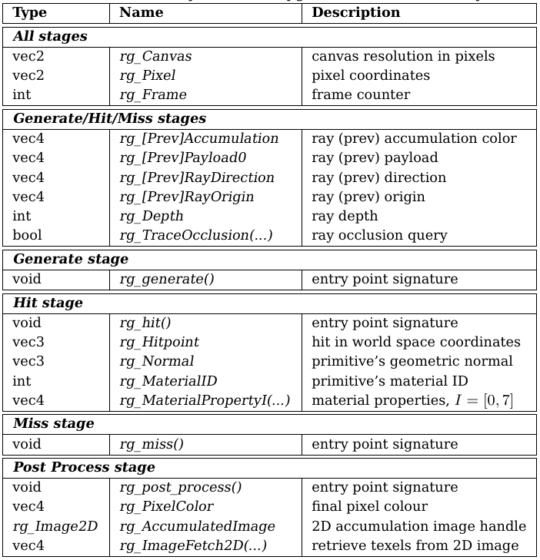
Rayground API
Experiments
Simple & intuitive API
Mapping to fundamental concepts of RT
Correspondence to the gl_ namespace
Notes:
Here is a quick reference to the Rayground API. The specifics of each variable do not matter here and we only want you to get a sense of how the API is structured. We wanted students to feel right at home. We wanted to map fundamental concepts of ray tracing to a gl-like API.

Slide 31
Rayground API
Experiments
Simple & intuitive API
Mapping to fundamental concepts of RT
Correspondence to the gl_ namespace
Notes:
For example, rays are submitted for intersections by assigning to the built-ins rg_RayDirection and rg_RayOrigin.

Slide 32
Rayground API
Experiments
Simple & intuitive API
Mapping to fundamental concepts of RT
Correspondence to the gl_ namespace
Notes:
Also, during the hit stage, the user is expectedly given access to built-in variables that hold the normal, position, material id and other intersection related values.

Slide 33
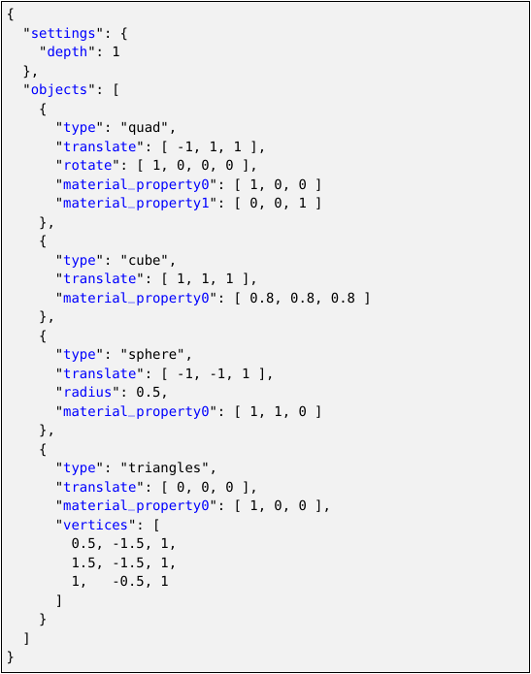
Scene Description
Experiments
Simple custom JSON format
Notes:
The scene is described using a simple custom JSON format. The inputs required are simulation settings and object geometry.

Slide 34
Scene Description
Experiments
Simple custom JSON format
Settings
simulation properties (e.g. recursion depth)
Notes:
The most common simulation setting is that of the recursion depth we discussed earlier.

Slide 35
Scene Description
Experiments
Simple custom JSON format
Settings
simulation properties (e.g. recursion depth)
Objects
Scene geometry
Supports several basic shapes and triangle soups
Notes:
As for objects, we made sure to add support for basic 3D shapes which are positioned in the scene using a transformation, rotation and scale triplet.

Slide 36
Scene Description
Experiments
Simple custom JSON format
Settings
simulation properties (e.g. recursion depth)
Objects
Scene geometry
Supports several basic shapes and triangle soups
For each object, the user can specify:
Object properties which become available during Hit events
3D positioning and scaling
Notes:
Per object material properties are also supported and become available at the Hit stage for use in local shading.

Slide 37
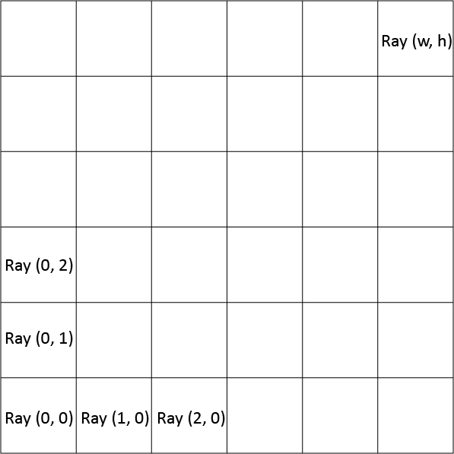
Ray Generation Stage
Experiments
Generate primary rays in parallel for each pixel
Typically used to set up a virtual camera
The user has access to the canvas dimensions and each pixel’s coordinates
Rays carry a payload and the pixel’s accumulation value
Notes:
During ray generation the user submits a code snippet that executes in parallel for each pixel. Given the pixel’s coordinates and canvas dimensions one can generate rays from a virtual camera. For flexibility each ray carries a user assignable payload and accumulation value.

Slide 38
Ray Generation Stage
Experiments
Generate primary rays in parallel for each pixel
Typically used to set up a virtual camera
The user has access to the canvas dimensions and each pixel’s coordinates
Rays carry a payload and the pixel’s accumulation value
The user “submits” rays for intersection by appropriately setting the rg_RayOrigin and rg_RayDirection built-ins.
Notes:
A ray is submitted in code by setting the built-in variables rg_RayOrigin and rg_RayDirection.

Slide 39
Ray Generation Stage
Experiments
Generate primary rays in parallel for each pixel
Typically used to set up a virtual camera
The user has access to the canvas dimensions and each pixel’s coordinates
Rays carry a payload and the pixel’s accumulation value
The user “submits” rays for intersection by appropriately setting the rg_RayOrigin and rg_RayDirection built-ins.
Ray payload and accumulation are initialized through rg_PayloadX and rg_Accumulation.
Notes:
Ray payload and accumulation are initialized through rg_PayloadX and rg_Accumulation.

Slide 40
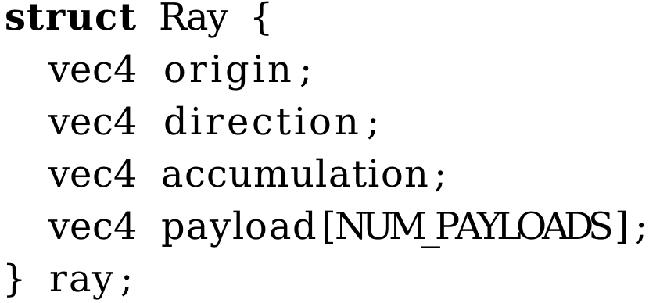
Ray Generation Stage
Experiments
Generate primary rays in parallel for each pixel
Typically used to set up a virtual camera
The user has access to the canvas dimensions and each pixel’s coordinates
Rays carry a payload and the pixel’s accumulation value
The user “submits” rays for intersection by appropriately setting the rg_RayOrigin and rg_RayDirection built-ins.
Ray payload and accumulation are initialized through rg_PayloadX and rg_Accumulation.
Notes:
It is easy to think of each ray as carrying a struct of the form showcased in the lower right corner of the slide.

Slide 41
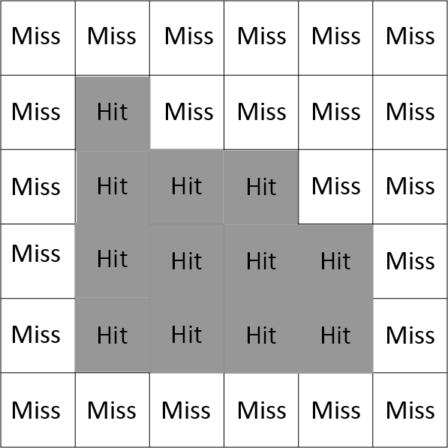
Miss/Hit Stage
Experiments
Previously submitted rays are intersected with the scene
A Miss or Hit event is triggered
Local shading and next event estimation commonly take place in this stage
In-shader visibility queries can be performed using rg_TraceOcclusion
Notes:
Submitted rays are consequently intersected with the scene and the framework triggers a miss or a hit event accordingly. This is where local shading commonly takes place. Visibility queries are also very useful in this stage and can be performed using the rg_TrraceOcclusion API function within the shader.

Slide 42
Miss/Hit Stage
Experiments
Previously submitted rays are intersected with the scene
A Miss or Hit event is triggered
Local shading and next event estimation commonly take place in this stage
In-shader visibility queries can be performed using rg_TraceOcclusion
The user “submits” new secondary rays for intersection by appropriately setting the rg_RayOrigin and rg_RayDirection built-ins.
Notes:
Secondary rays are submitted in-code, again by assigning to the built-in variables rg_RayOrigin and rg_RayDirection.

Slide 43
Miss/Hit Stage
Experiments
Previously submitted rays are intersected with the scene
A Miss or Hit event is triggered
Local shading and next event estimation commonly take place in this stage
In-shader visibility queries can be performed using rg_TraceOcclusion
The user “submits” new secondary rays for intersection by appropriately setting the rg_RayOrigin and rg_RayDirection built-ins.
Ray payload and accumulation are updated through rg_PayloadX and rg_Accumulation.
Notes:
Ray payload and ray accumulation are further updated through rg_PayloadX and rg_Accumulation.

Slide 44
Miss/Hit Stage
Experiments
Previously submitted rays are intersected with the scene
A Miss or Hit event is triggered
Local shading and next event estimation commonly take place in this stage
In-shader visibility queries can be performed using rg_TraceOcclusion
For each pixel, the process continues until the max depth iteration is reached or the ray is set to inactive
Notes:
These newly submitted rays, are in-turn intersected with the scene potentially triggering new miss or hit events. A pixel’s shader execution only stops when the max depth iteration is reached or its ray is set to inactive.

Slide 45
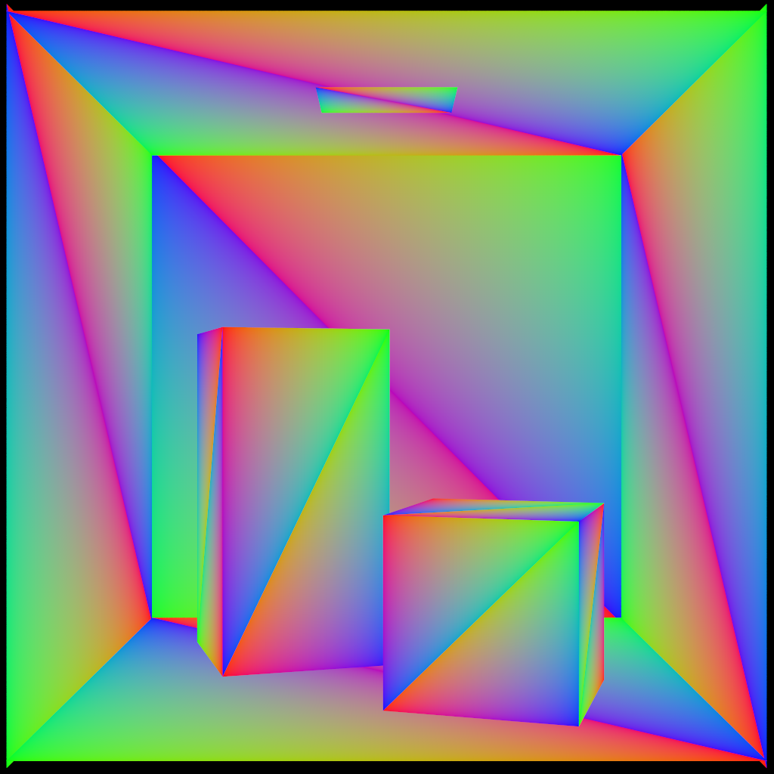
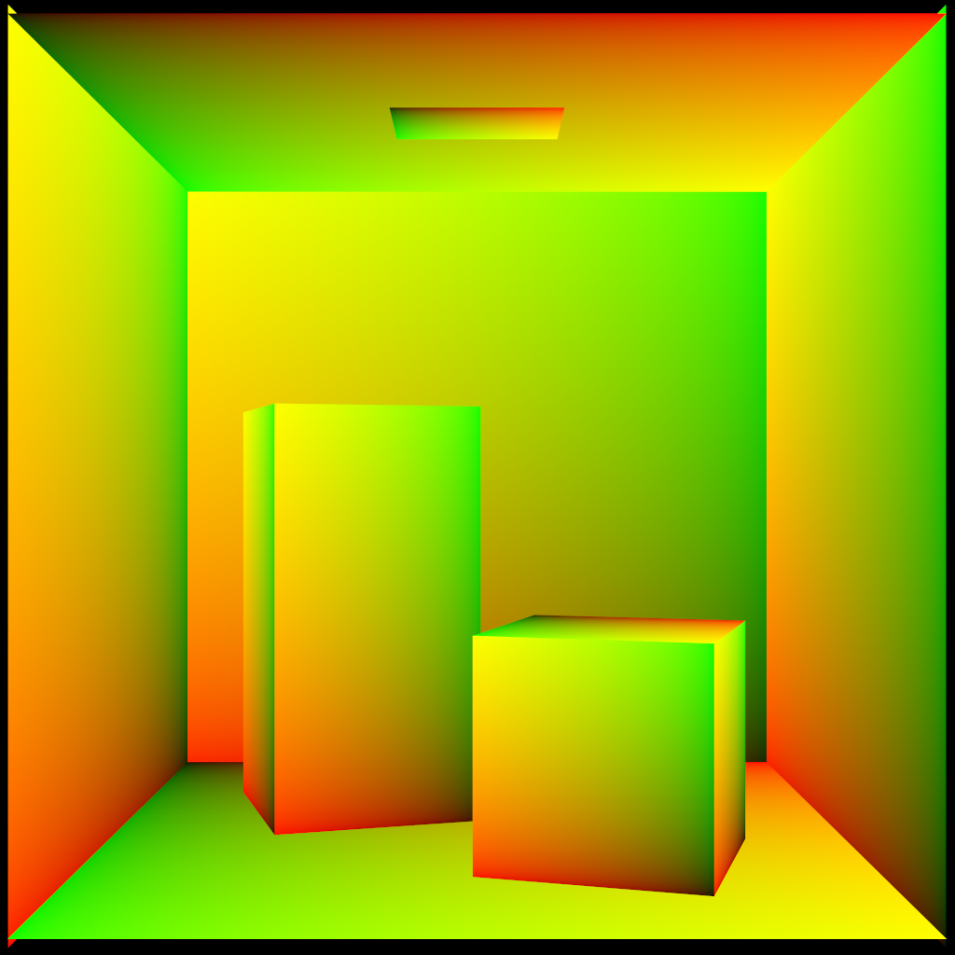
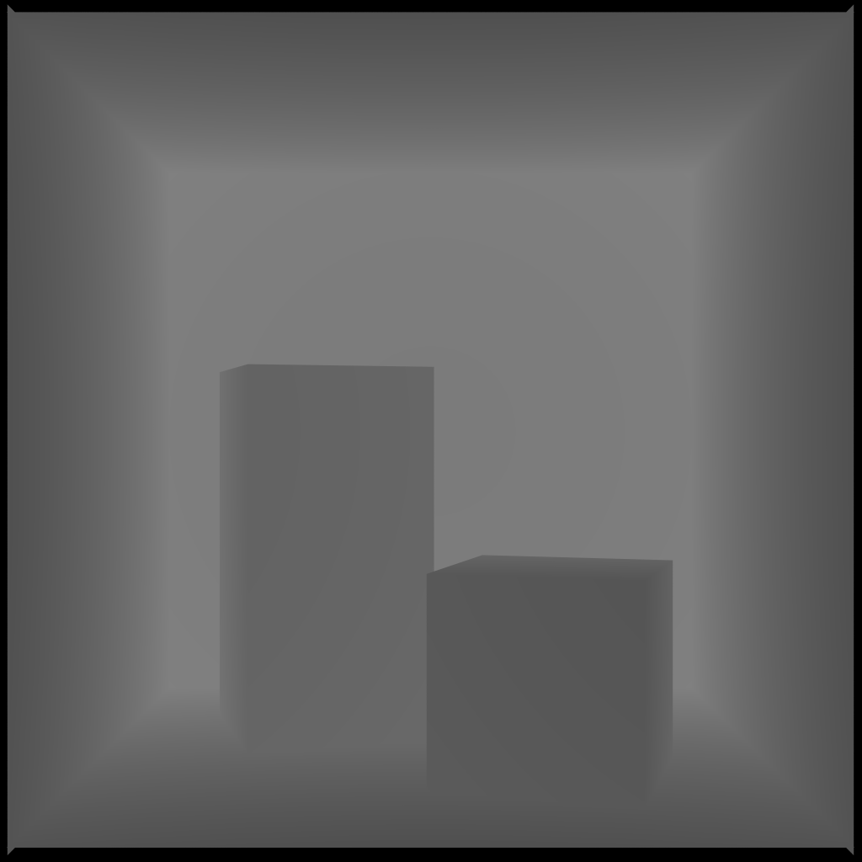
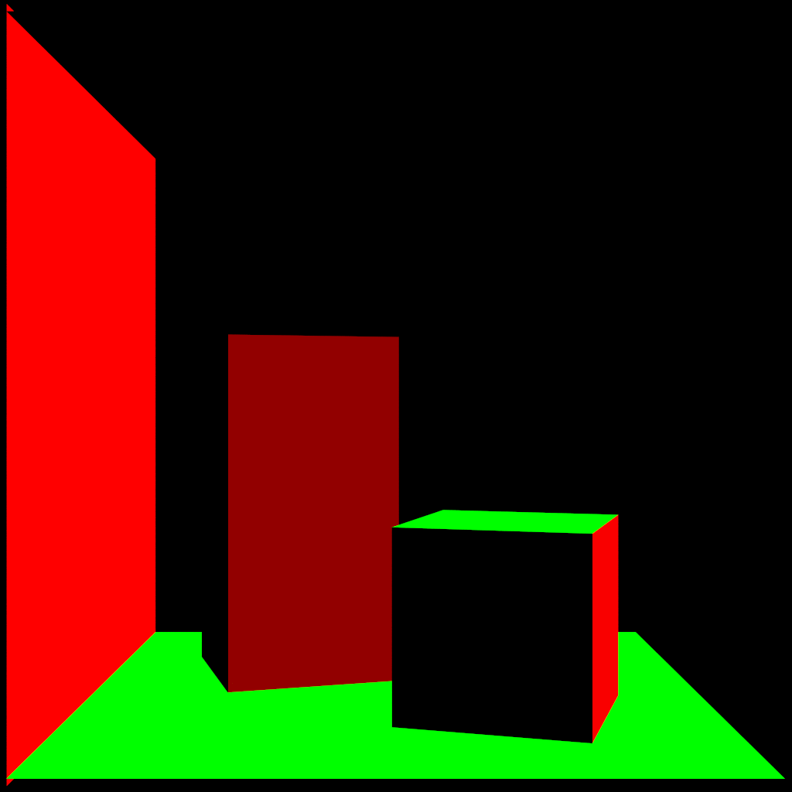
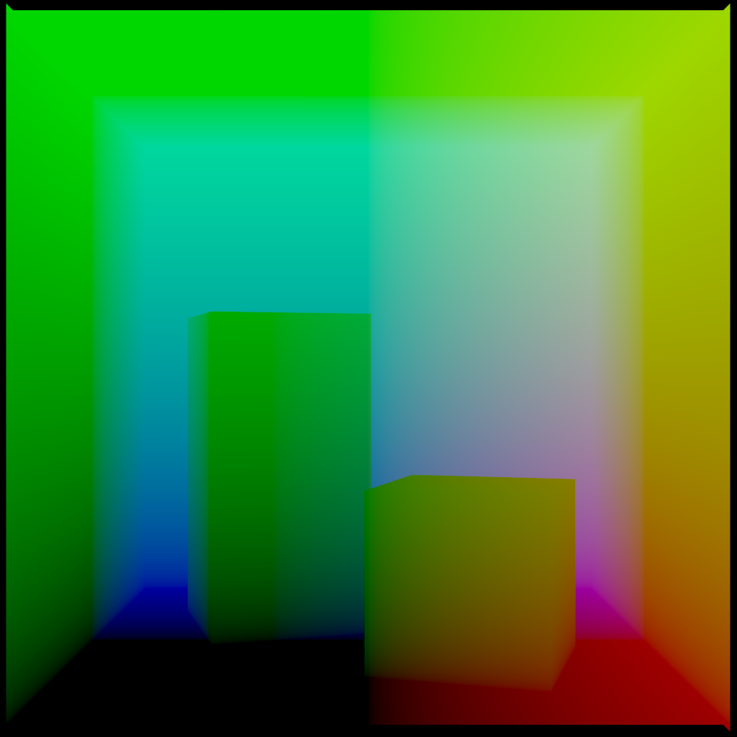
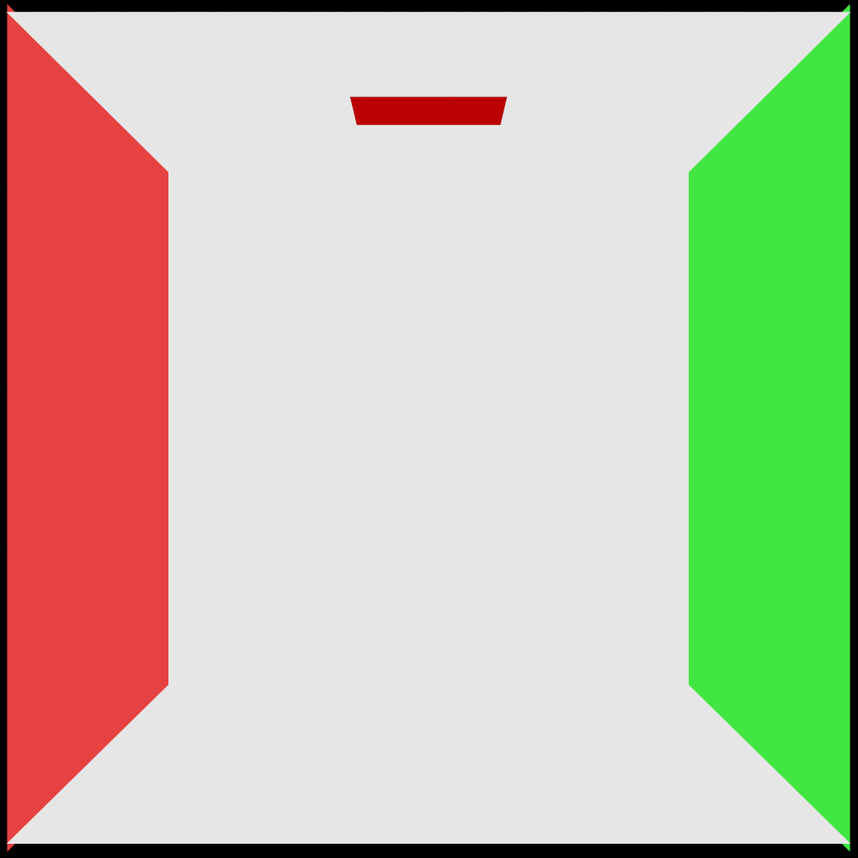
Hit Stage
rg_BaryCoords
rg_TexCoords
rg_Distance
rg_Normal
rg_Hitpoint
rg_MaterialProperty0
Notes:
Here is a preview of some of the built-ins exposed through the API during hit events. These are the values after the first-bounce event. They are useful for appearance shading and next event estimation.

Slide 46
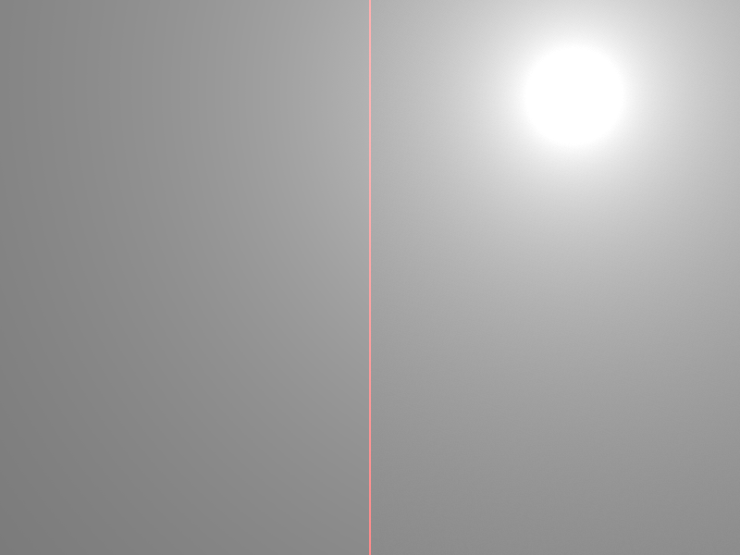

Miss Stage
Background Light Source
Sky Gradient
Notes:
The miss event type does not expose any geometric properties but is used for background coloring.

Slide 47
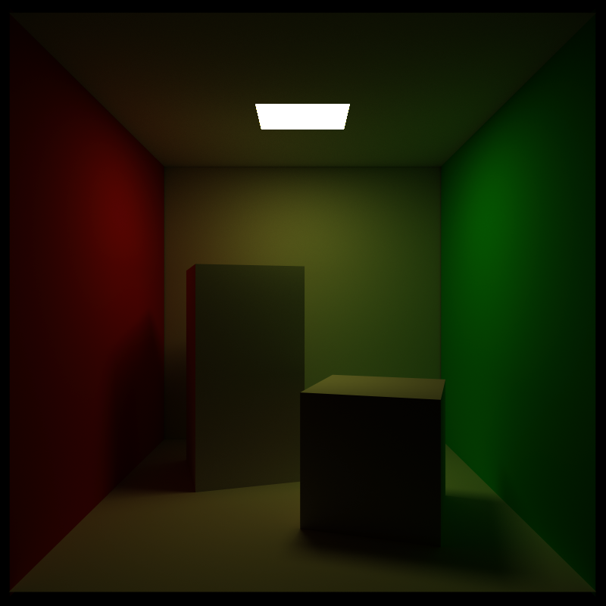
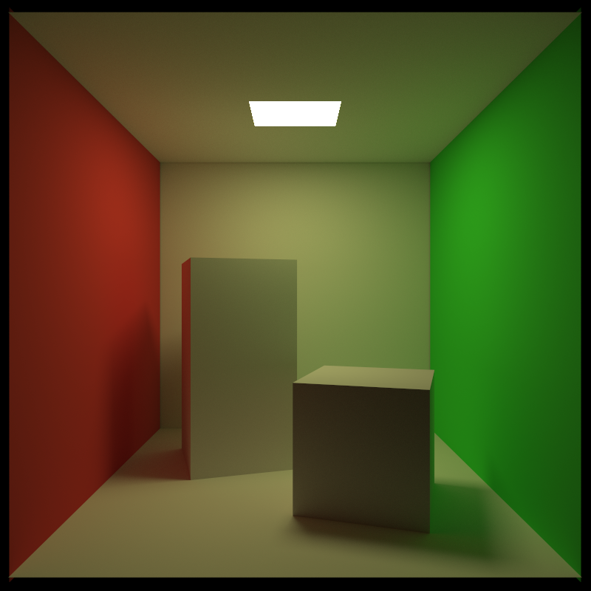
Post Process Stage
Experiments
One of the most important steps in image synthesis. The user gains random access to the accumulation buffer. Typical use cases include:
Tone Mapping
Gamma Correction
Denoising
Filters
e.t.c.
Before Gamma Correction
After Gamma Correction
Notes:
Finally, after the recursion depth has been reached and accumulation has taken place, the user gains random access to the accumulation buffer in the final post processing stage. All sorts of filters can be applied here, some relevant to ray tracing in particular and some relevant to computer graphics in general.

Slide 48
Computer Graphics Course
Experiments
How can you exploit Rayground to improve your CG course?
Interactive lectures
Lab coursework
Live examination
Exercises
Self-study
We designed coursework using Rayground for both undergraduate and graduate courses
Notes:
Rayground’s design had teaching at its core and for the time-being had to co-exist with a rasterization-based teaching solution. Through rapid prototyping, high interactivity and familiarity offered by GLSL, it’s a perfect fit for the introduction of ray tracing after spending time in courses in order to teach OpenGL and the standard graphics pipeline.
We considered Rayground for interactive lectures, lab coursework, live examination, exercises, self-study and more.
We designed coursework using Rayground for both undergraduate and graduate courses

Slide 49
Undergraduate Course
Experiments
Rendering pipeline abstraction:
Geometry setup
Sample/fragment generation
Shading
Compositing
Notes:
For the undergraduate course structure, to facilitate the inclusion of a new tool alongside a standard rasterization-based framework, we abstracted the rendering pipeline. We divided it into four generic stages: a) geometry setup, b) sampling/fragment generation, c) shading and d) compositing so that they could be independently mapped to rasterization or ray tracing accordingly. This allowed common topics to remain separate from the underlying pipeline.

Slide 50
Undergraduate Course
Experiments
Rendering pipeline abstraction:
Geometry setup
Sample/fragment generation
Shading
Compositing
Separate common topics from pipeline specifics:
Material properties
Local shading
Geometry representation
Texturing
Image-domain sampling
Antialiasing
e.t.c.
Notes:
Topics such as, material properties, local shading, geometry representation, texturing, image-domain sampling, antialiasing e.t.c.

Slide 51
Undergraduate Lectures
Experiments
Interactively demonstrate ray tracing concepts during lectures
Implementation and theory can now walk hand in hand
Active student participation
Correlate presented concepts with their practical implementation
Notes:
The actual lectures were enriched with interactive demonstrations of ray tracing concepts using Rayground. Implementation and theory could now walk hand in hand. This prompted more students to actively participate and helped them quickly correlate presented concepts with their practical implementation.

Slide 52
Undergraduate Labs
Experiments
Lab coursework
Rasterization
5 Labs (10 hours)
Ray Tracing
2 Labs (4 hours)
Assignment-related topics
1 Lab (2 hours)
Notes:
As is common, our computer graphics lectures are supported by a series of practical exercises in a lab. We have 5 labs devoted to rasterization, 2 to ray tracing and 1 for assignment related topics.

Slide 53
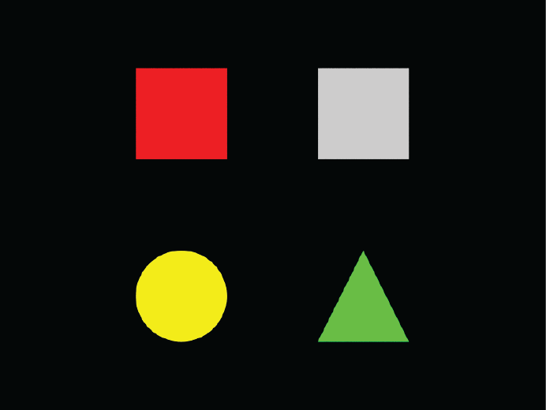
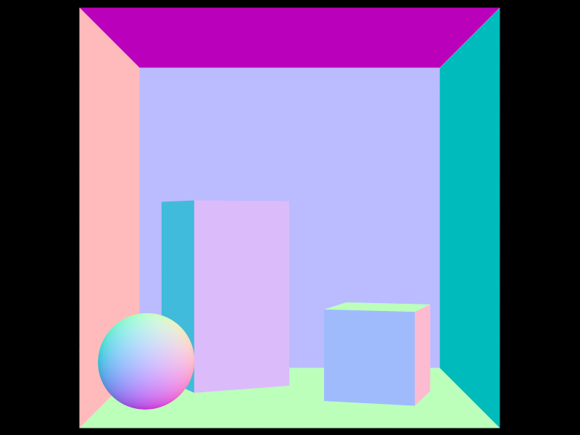
Undergraduate Labs
Experiments
Lab 1
Introduction (1 hour)
Familiarize with Rayground
Explain programmable stages
Scene setup
Orthographic camera ray generation
Introduce object properties
Notes:
We had a lot of ground to cover for the 2 ray tracing labs. Here is how we structured them using Rayground. Lab 1 had an introductory 1-hour session where we familiarize students with the Rayground interface, explain the programmable pipeline and the scene definition format. We would then setup a simple orthographic camera and introduce the basic object properties provided by the Rayground API.

Slide 54
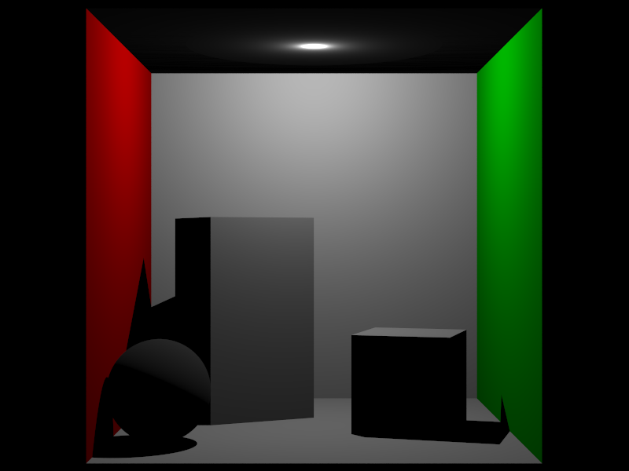
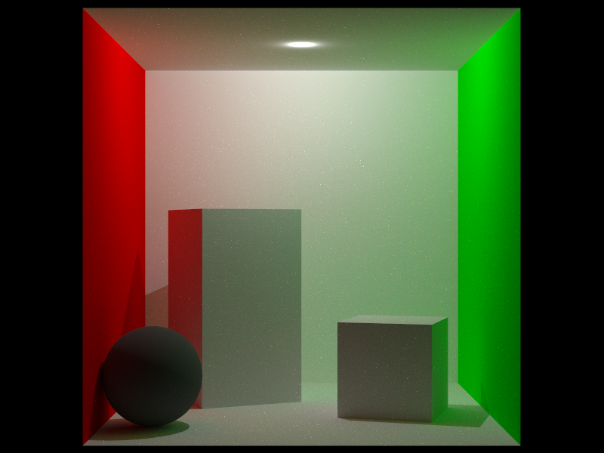
Undergraduate Labs
Experiments
Lab 1
Live Coding (1 hour)
Perspective camera ray generation
Direct lighting with visibility
Cornell box with Lambert BRDF and point light source
Post Processing
Notes:
We then introduce image synthesis using ray tracing. A perspective camera is setup. Direct lighting from point light sources with visibility queries is added. Then, a basic global illumination algorithm is implemented using the Lambert BRDF and next event estimation. Finally, post processing is discussed.

Slide 55
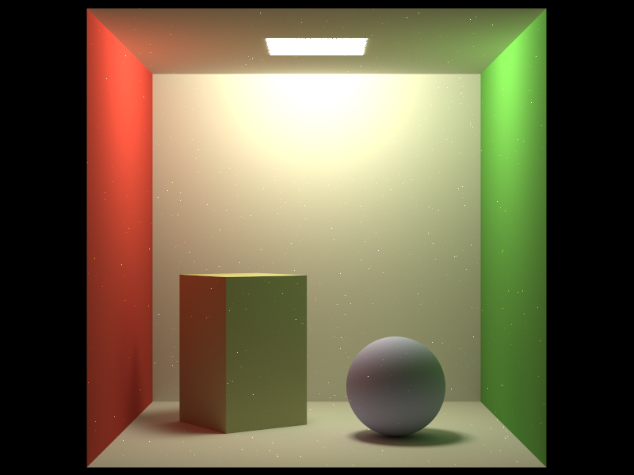
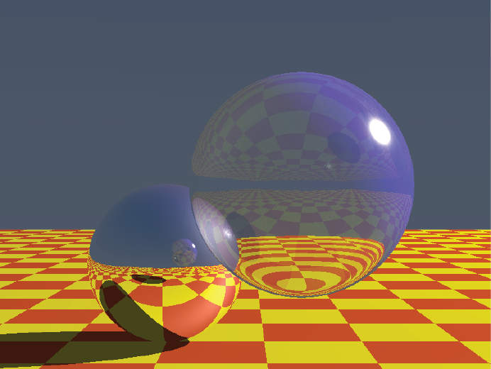
Undergraduate Labs
Experiments
Lab 2
Cornell Box
Area Lights
Soft Shadows
Sampling
Anti-Aliasing
Whitted-style Ray Tracing
Textures
Glossy Reflections
Refraction
Notes:
The second lab covers even more advanced topics. The Cornell box from the fist lab is extended with area lights, soft shadows, sampling and anti-aliasing. Finally, we setup a whitted-style ray tracing demo scene where we implement procedural textures, glossy reflections and refraction. We emphasize on the fact that all these effects are very hard to implement in rasterization and how ray tracing allows us to generate these pretty pictures in an elegant manner.

Slide 56
Graduate Course
Experiments
Wide range of topics
Varying student background
A lot of ground to cover
Basic ray tracing concepts
Light transport theory
Path-space sampling
Notes:
When designing the graduate course, our main concern was with the fact that we wanted to incorporate a wide range of topics and accommodate varying student backgrounds. In terms of ray tracing alone, we also had to cover a lot of ground, including basic ray tracing concepts, light transport theory and path-space sampling.

Slide 57
Graduate Course
Experiments
Wide range of topics
Varying student background
A lot of ground to cover
Basic ray tracing concepts
Light transport theory
Path-space sampling
together with…
Rasterization
Visualization tools and techniques
VR technologies
Applications
e.t.c.
Notes:
These would have to be combined together with rasterization, visualization tools and techniques, VR technologies, graphics applications e.t.c.

Slide 58
Graduate Course
Experiments
Wide range of topics
Varying student background
A lot of ground to cover
Basic ray tracing concepts
Light transport theory
Path-space sampling
together with…
Rasterization
Visualization tools and techniques
VR technologies
Applications
e.t.c
Labs need to follow this pace and Rayground helped tremendously.
Notes:
Rayground helped us even more when designing the graduate lab course.

Slide 59
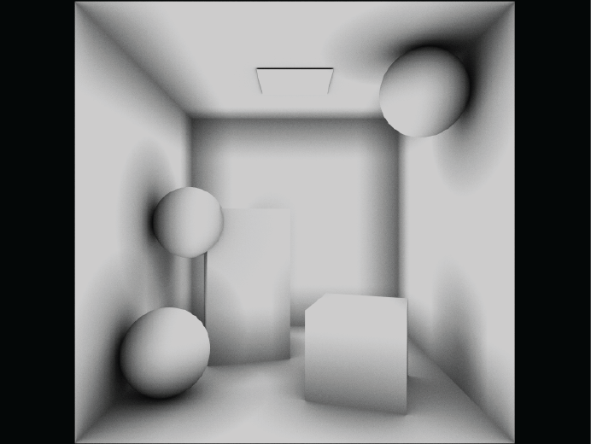
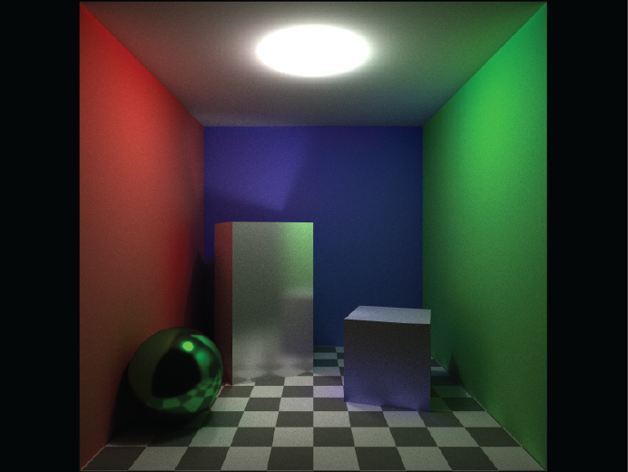
Graduate Labs
Experiments
Lab 1, 2 (4 hours)
Same as undergraduate labs
Lab 3 (2 hours)
Visibility Determination
Ambient Occlusion
Physically-based BRDFs
Importance Sampling BRDFs
Notes:
We devoted 4 two-hour Labs to ray tracing. The first two labs covered the same topics as the undergraduate labs in order to get unacquainted students up to speed. Lab 3 continues with more advanced topics like visibility determination, ambient occlusion, physically-based BRDFs and importance sampling of BRDFs.

Slide 60
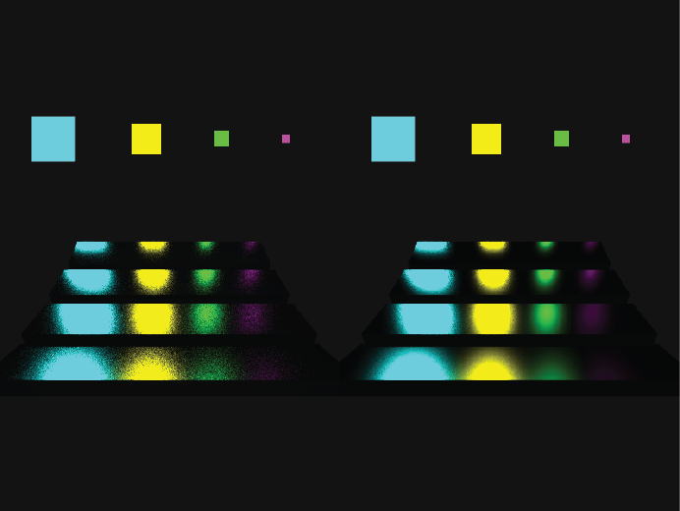
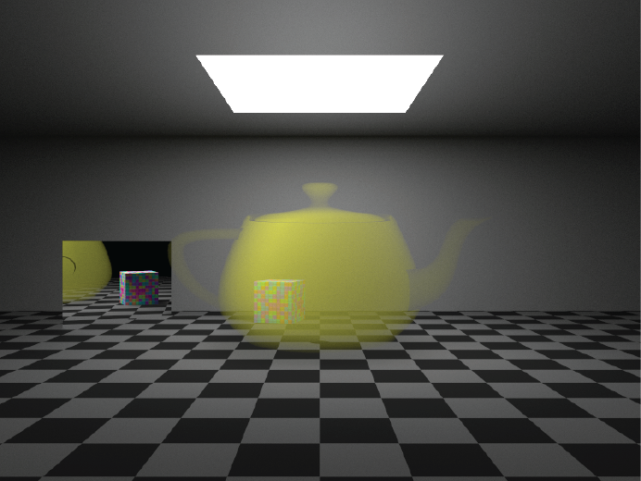
Graduate Labs
Experiments
Lab 4 (2 hours)
Multiple Importance Sampling
Path-space Sampling
Scattering Events
Phase Functions
Volumetric Light Transport
Notes:
Finally, the fourth lab introduces multiple importance sampling, path space sampling, scattering events, phase functions and volumetric light transport.

Slide 61
Evaluation
Experiments
The majority of students found Rayground very intuitive
It helped them gain a better understanding of ray tracing concepts
It was also welcomed as a companion tool for lectures
The interactive nature of the tool inspired them to experiment further with ray tracing
Many students showed preference to ray tracing
Notes:
The introduction of Rayground was an exciting and productive experience for both instructors and students. Most students quickly caught up with the API and the mechanics which they found very intuitive. Both as an interactive platform and a companion tool for lectures, it helped them understand fundamental concepts better and inspired them to experiment further with ray tracing. A lot of them were instantly drawn to ray tracing’s elegance and potential for realistic image synthesis compared to rasterization.

Slide 62
Future Educational Directions
Experiments
Current limitations:
Animation Systems
Bidirectional Methods
Also we are looking forward to:
A broader case study
The continuous evolution of courses based on Rayground
Notes:
Rayground cannot yet accommodate certain fundamental computer graphics concepts mainly due to the current status of web-based graphics technology. Two of our major concerns include animation systems and bidirectional methods which are instrumental to image synthesis.
We are also looking forward to a broader case study and the continuous evolution of courses based on Rayground over the coming years.

Slide 63
Future Directions
Experiments
More than an educational tool...
A platform for the graphics community
Share, develop and publish ideas on ray tracing
Present best practises
Propose new methods
Make standard algorithms indexable and reproducible
Notes:
As a closing note, we believe that Rayground can be more than an educational tool. It can serve as a community hub for ray tracing related subjects where people share, develop and publish ideas. The high availability of the Web makes it a suitable place to present best practises and propose new methods. Standard algorithms like BRDFs, light sampling, filters, denoizers and others can be made indexable and reproducible for everyone online.

Slide 64

Future Directions
Experiments
More than an educational tool...
A platform for the graphics community
Share, develop and publish ideas on ray tracing
Present best practises
Propose new methods
Make standard algorithms indexable and reproducible
Technology is with us…
WebGL support is improving
WebGPU is coming
Notes:
Thankfully technology is also advancing, with WebGL support constantly improving and the new WebGPU specification for accelerated graphics and compute on the Web on its way. We are working towards a major release very soon.

Slide 65

Acknowledgements
Experiments
This work was supported by the Hellenic Foundation for
Research and Innovation (HFRI) and the General Secretariat for
Research and Technology, under the HFRI PhD Fellowship
grant with GA No. 1545
http://graphics.cs.aueb.gr
www.rayground.com

Slide 66
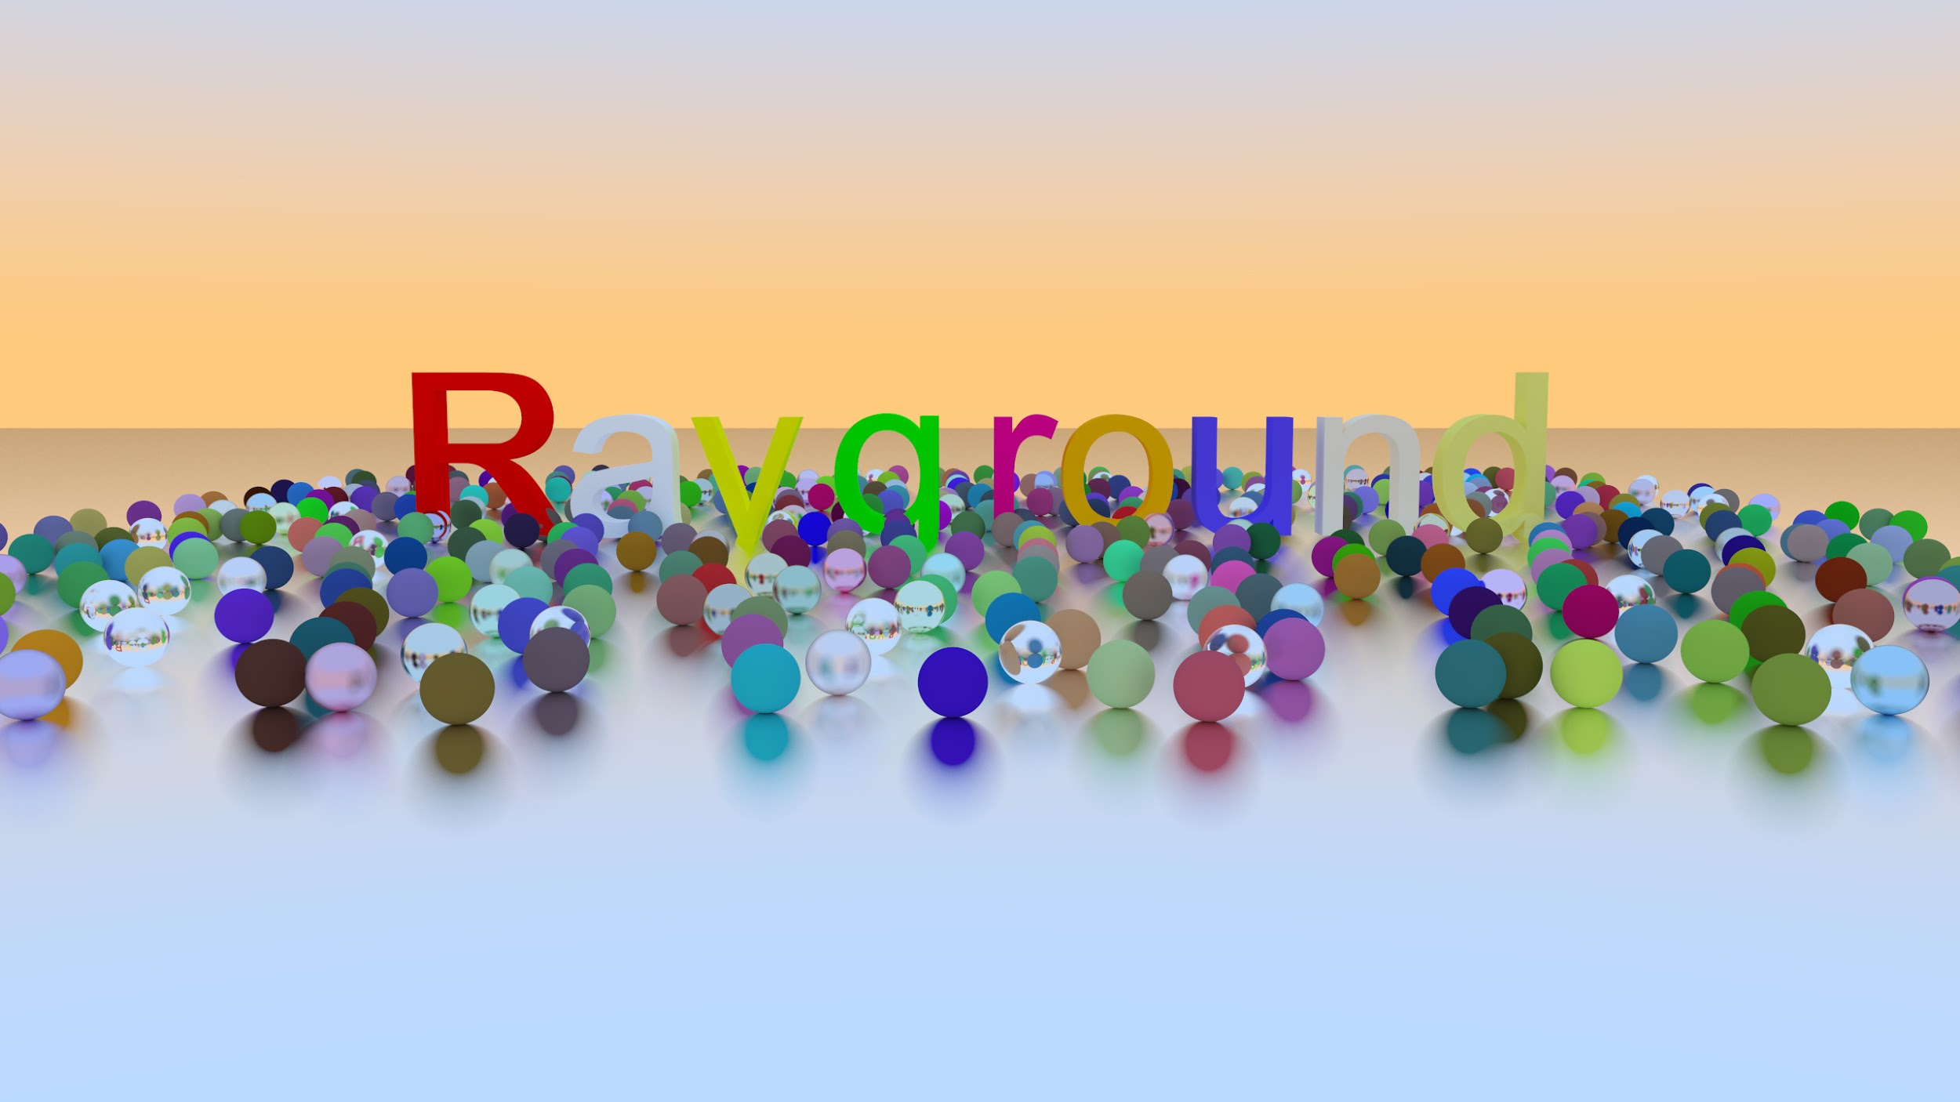
Questions
Experiments
Thank you!
Notes:
Thank you very much

